Slide 1

Policy Gradient Methods (II): Baseline Methods Keshav Pingali

Slide 2
Organization
Deterministic and probabilistic control
Policy network π and its parameters θ
Basic policy gradient method: REINFORCE
Monte Carlo sampling to estimate gradient of expected reward
Suffers from high variance → requires many samples
Baseline methods for reducing variance
Based on control variates methods from Monte Carlo literature
Baselines in policy-gradient computation: optimal and value-based baselines
Implementation: actor-critic methods
Trust-region methods for improving stability and sample efficiency
Ensure updates to θ are small
Trust Region Policy Optimization (TRPO): KL-divergence
Proximal Policy Optimization (PPO): bounding box around current values

Slide 3
Baselines and Control Variates in Monte Carlo Integration

Slide 4
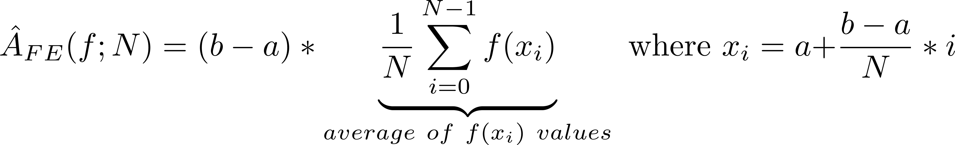
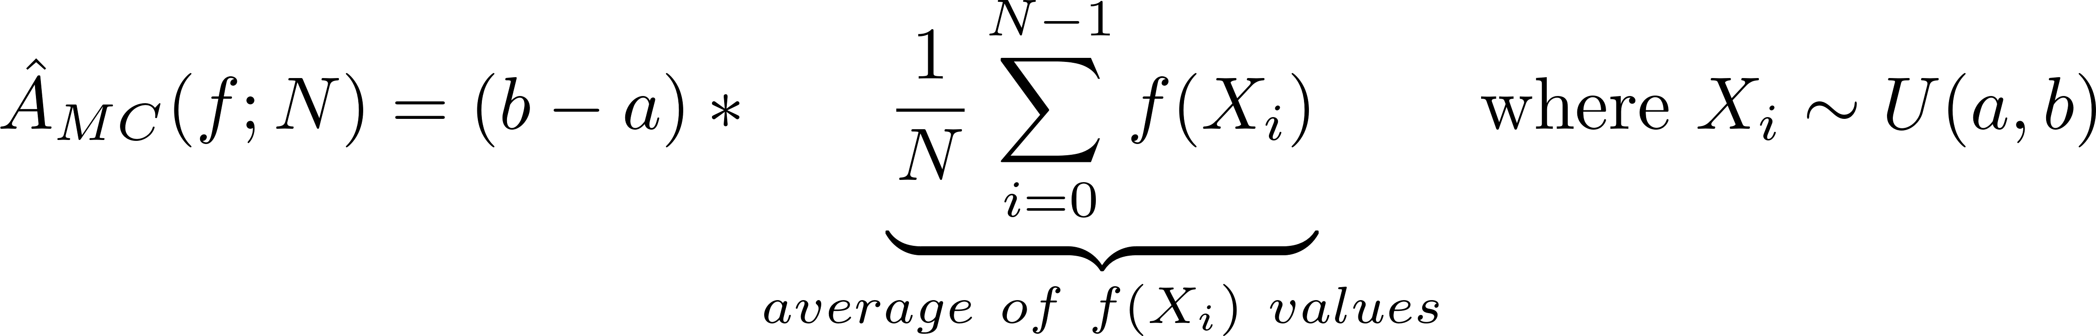
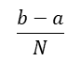
Monte Carlo integration w/uniform sampling (I)
f(x)
f(x)
x
x₃
x
a
x₁
x₂
x₃
b
a
x₂
x₄
x₁
b
$$\frac{b−a}{N}$$
Reinterpret forward-Euler/backward-Euler
Generate x_{i} values using arithmetic progression
Take average of f(x_{i}) values and multiply by (b-a)
Monte Carlo integration (capital letters for random variables)
Generate X_{i} values by sampling uniform distribution U(a,b)
Take average of f(X_{i}) values and multiply by (b-a)
What does it mean for a random variable to approximate a deterministic quantity?

Slide 5
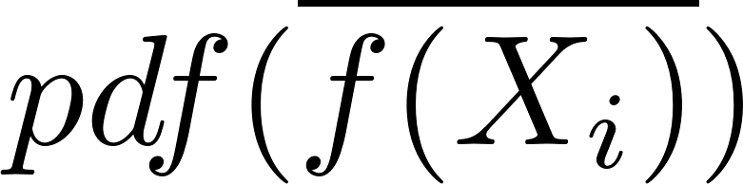
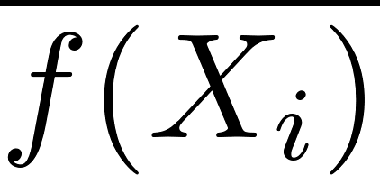
Key concepts
Estimand: quantity whose value we want to know
(e.g.) area under the curve (a real number)
Estimate: approximation for estimand based on random observations (samples)
(e.g.) result of Monte Carlo sampling
Estimator: rule for computing estimate from samples
Observations (samples) are random variables so estimates produced by an estimator are also random variables, which have a mean and variance
Unbiased estimator: expectation of estimate produced by the estimator = true value
Sample variance: how different are estimates produced by an estimator for different sets of observations of same size
Higher variance → need more samples to obtain a given level of accuracy in estimate
N=100
N=20
N=1
f_{min}
f_{max}

Slide 6
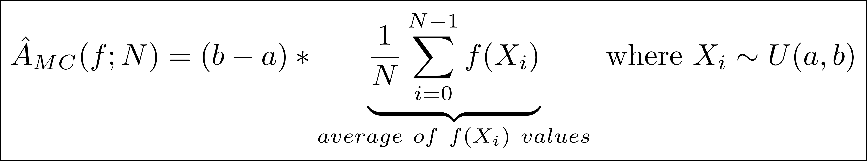
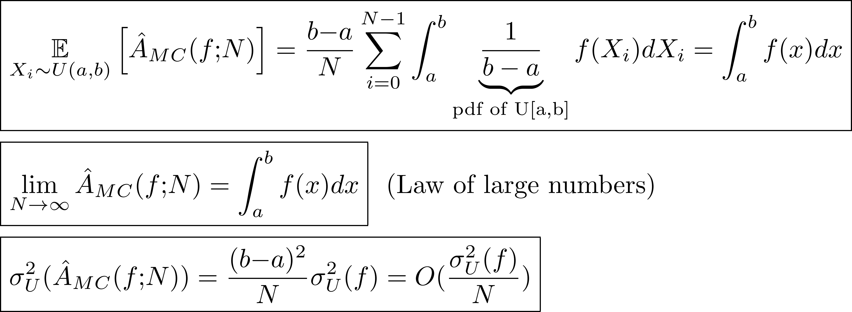
Monte Carlo integration with uniform sampling(II)
Unbiased estimator
N=100
N=20
N=1
f_{min}
f_{max}
Convergence in probability
If f has high variance, need lots of samples to obtain accurate estimate

Slide 7
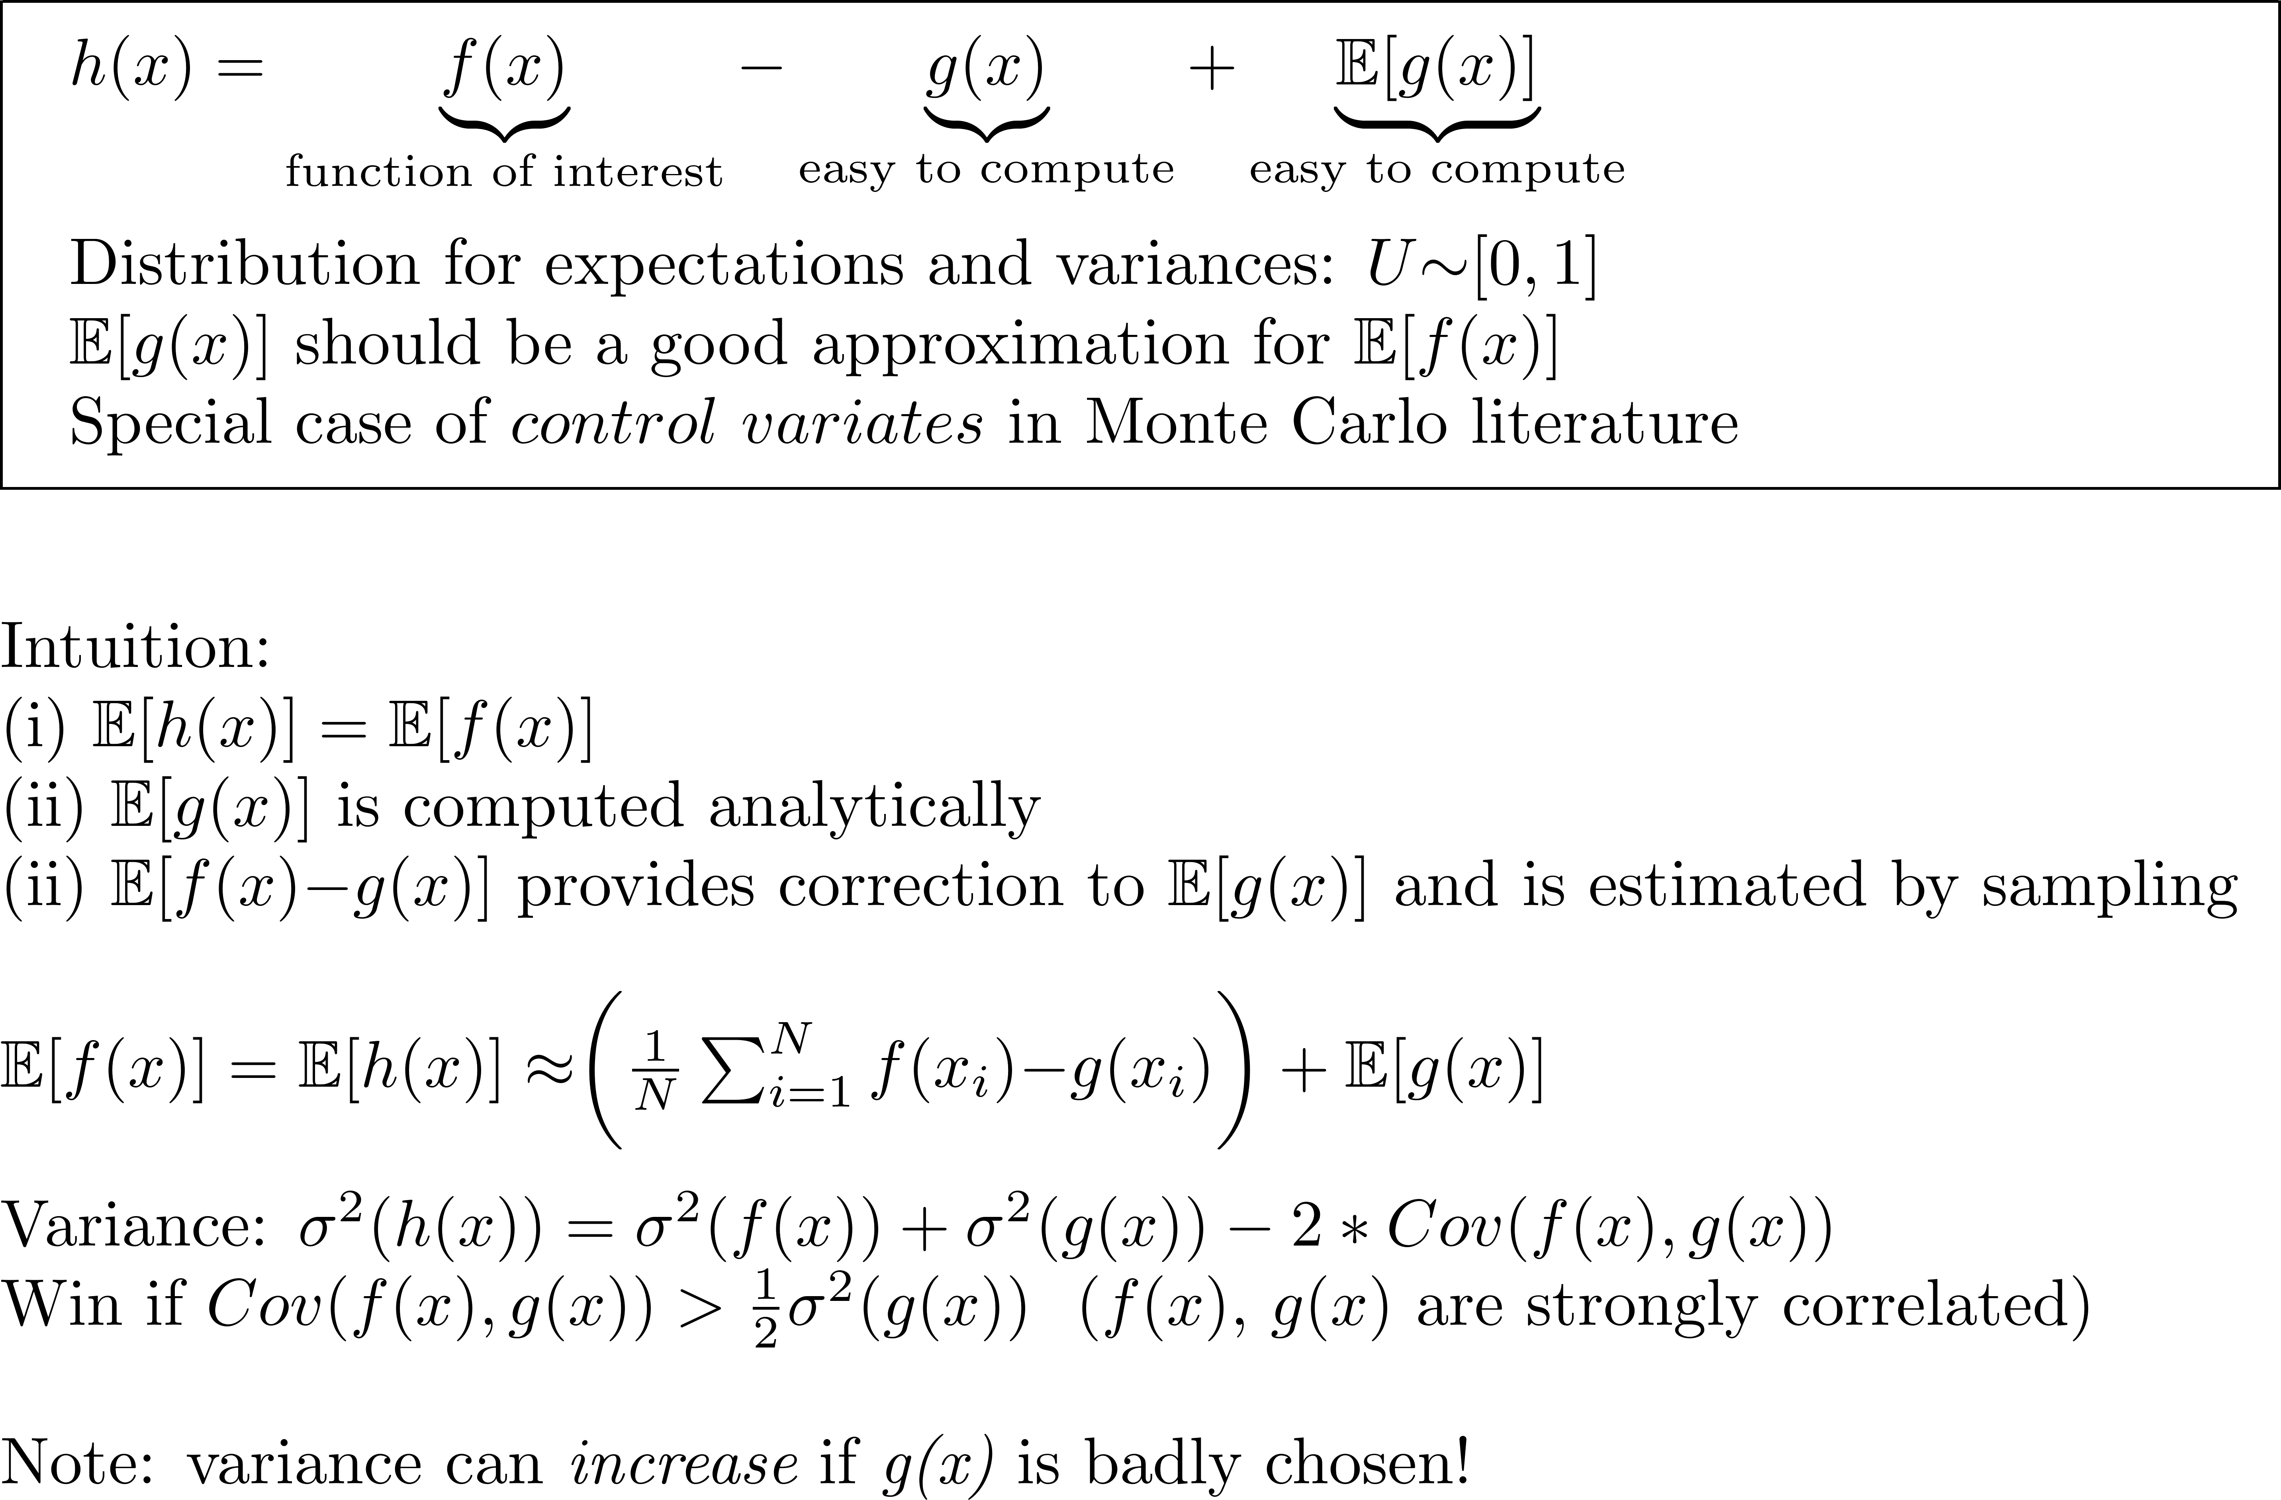
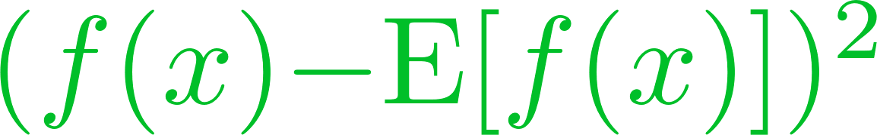
Baseline method for reducing variance
f(x)
g(x)
E[f(x)]
0
1
x
U ∼ [0,1]
g(x) is a baseline for f(x)

Slide 8
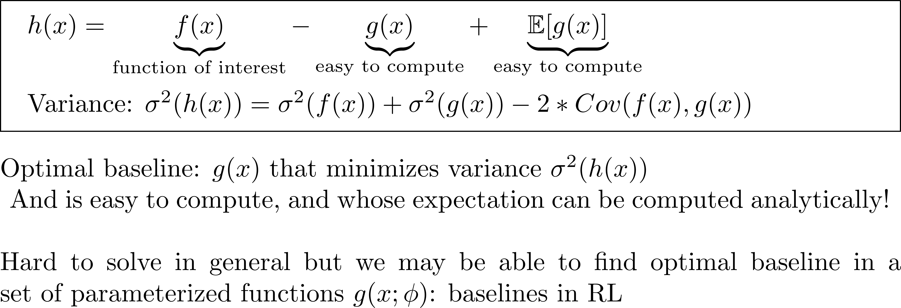
Optimal baseline
f(x)
g(x)
E[g(x)]
0
1
x
U ∼ [0,1]
g(x) is a baseline for f(x)

Slide 9
Baselines in Policy-gradient Computation

Slide 10
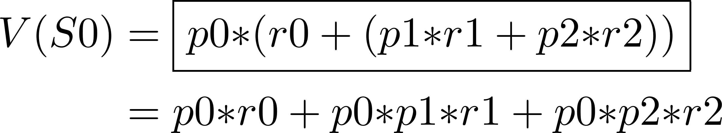
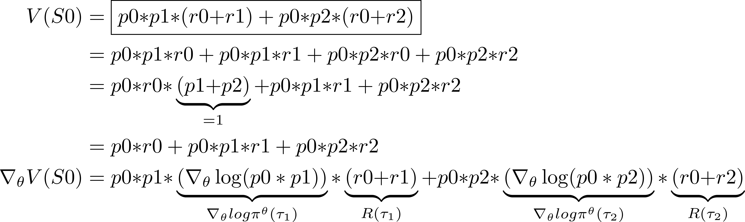
Review: example from last time
Bellman:
Trajectories:
S0
_{p0,r0}
τ1
τ2
_{p1,r1}
_{p2,r2}
θ = θ + η∇_{θ} V(S0)

Slide 11
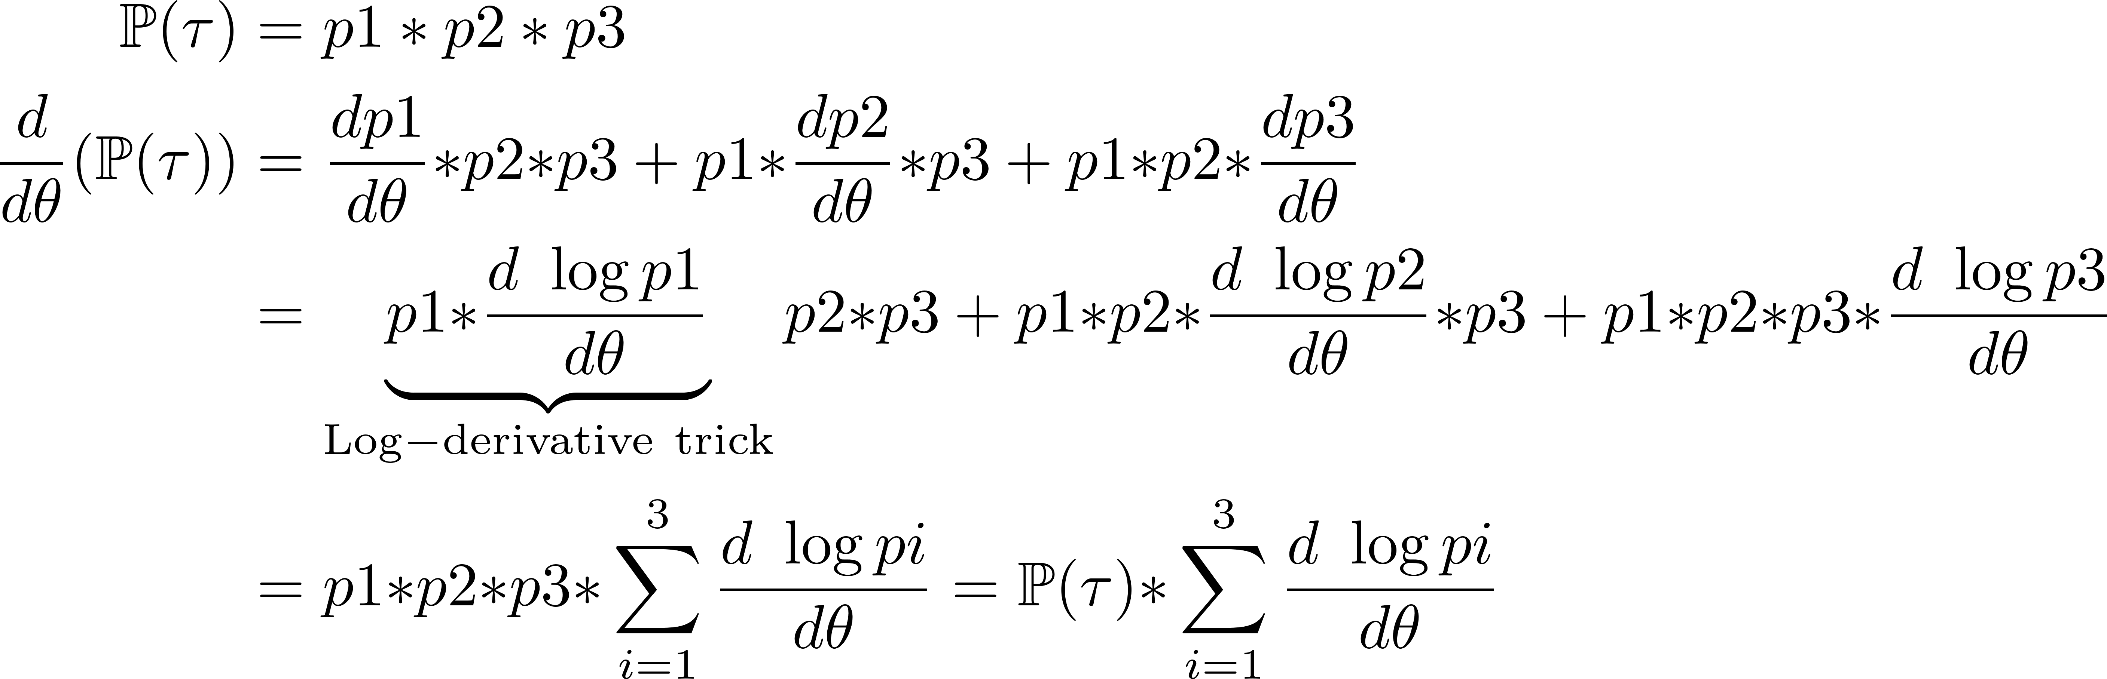
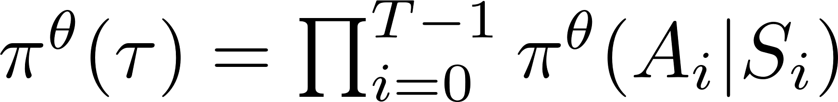
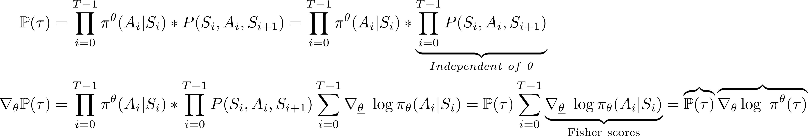
Why we need Monte Carlo sampling of trajectories
τ:
p1
p2
p3
τ:
S₀
A₀
S₁
A₁
S_{T}
……..
Cannot compute
so estimate with MC:
probability ≈ frequency
π^{θ}(A₀|S0)*P(S₀,A₀,S₁)
π^{θ}(A₁,S₁)*P(S₁,A₁,S₂)
Obtain from NN

Slide 12
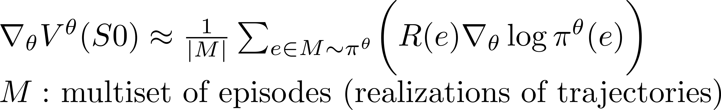
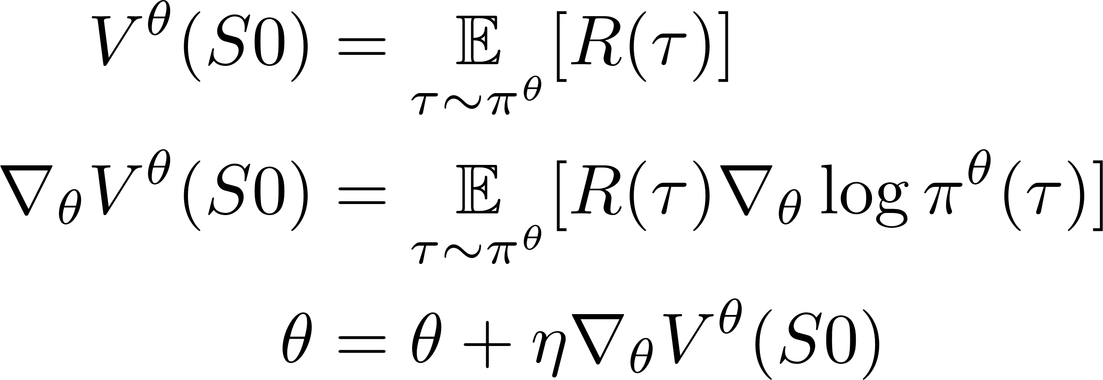
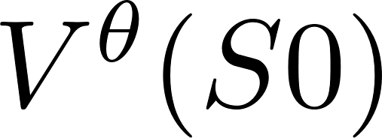
Key steps
Advantage
Actor-critic method
Baselines for variance reduction
π^{θ}
S0
e
Episodes
REINFORCE
Monte Carlo sampling
π^{θ}
τ
Trajectories
S0
Policy-gradient theorem
MDP DAG
Bellman iteration
S0

Slide 13
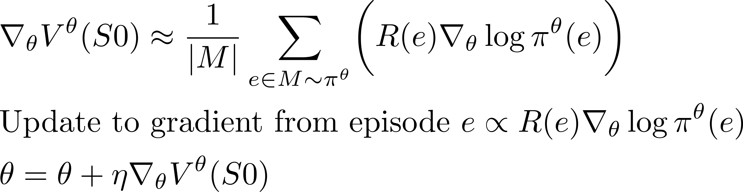
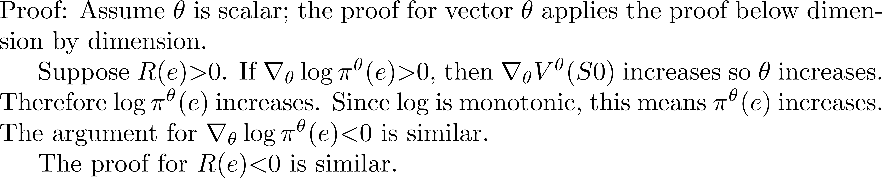
Intuition about policy gradients
π^{θ}(e)
e
R(e)
Claim: R(e) > 0: update to θ increases π^{θ}(e) (path becomes more probable) R(e) < 0 : update to θ decreases π^{θ}(e) (path becomes less probable)

Slide 14

Inefficiency in REINFORCE
π^{θ}(e1)
e1
R(e1) = 10
π^{θ}(e2)
R(e2) = 2
e2
R(e) > 0: update to θ increases π^{θ}(e) (path becomes more probable) R(e) < 0 : update to θ decreases π^{θ}(e) (path becomes less probable)
Gradient ascent should converge to θ that maximizes π^{θ}(e1)
However, whenever e2 is sampled, it pulls probabilities to itself since R(e2) > 0.
Result: θ updates are noisy, and convergence is slow.
Intuitively, REINFORCE has no “memory” of past episodes (history) except to the extent that they are incorporated implicitly into π^{θ}

Slide 15
Intuitive idea of baseline
π^{θ}(e1)
e1
R(e1) = 10
R(e1) = 5
π^{θ}(e2)
R(e2) = -3
R(e2) = 2
e2
R(e) > 0: update to θ increases π^{θ}(e) (path becomes more probable) R(e) < 0 : update to θ decreases π^{θ}(e) (path becomes less probable)
One idea: subtract a constant b(aseline) between 2 and 10 (say 5) from both rewards.
Now e2 has negative reward so it repels probabilities while e1 still attracts probabilities
Result: θ updates are less noisy, and convergence is faster
If b >> 10 or b << 2, variance increases!
Question: is there an optimal baseline value?
r_{min}
r_{max}
good
baseline values

Slide 16
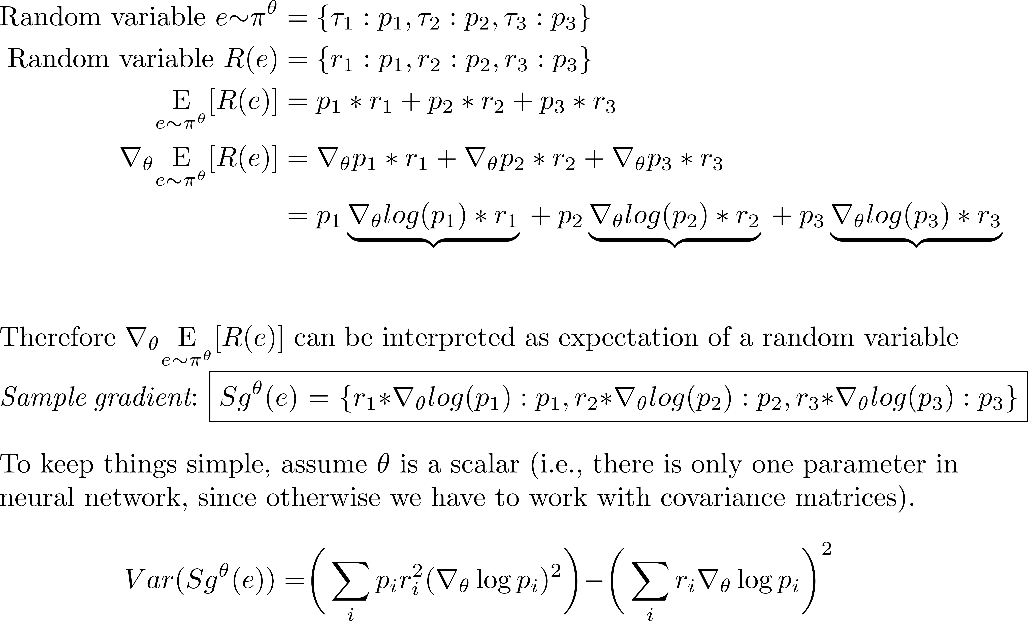
Variance in gradient estimation
S0
τ₁
p₁,r₁
τ₂
p₂,r₂
τ₃
p₃,r₃
p₁+p₂+p₃=1
∇_{θ}p₁+ ∇_{θ} p₂+ ∇_{θ} p₃= 0
p1∇_{θ}log(p₁)+ p2∇_{θ} log(p₂)+ p₃∇_{θ} log(p₃)= 0

Slide 17
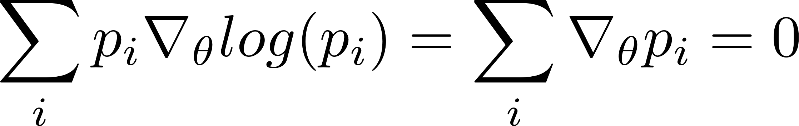
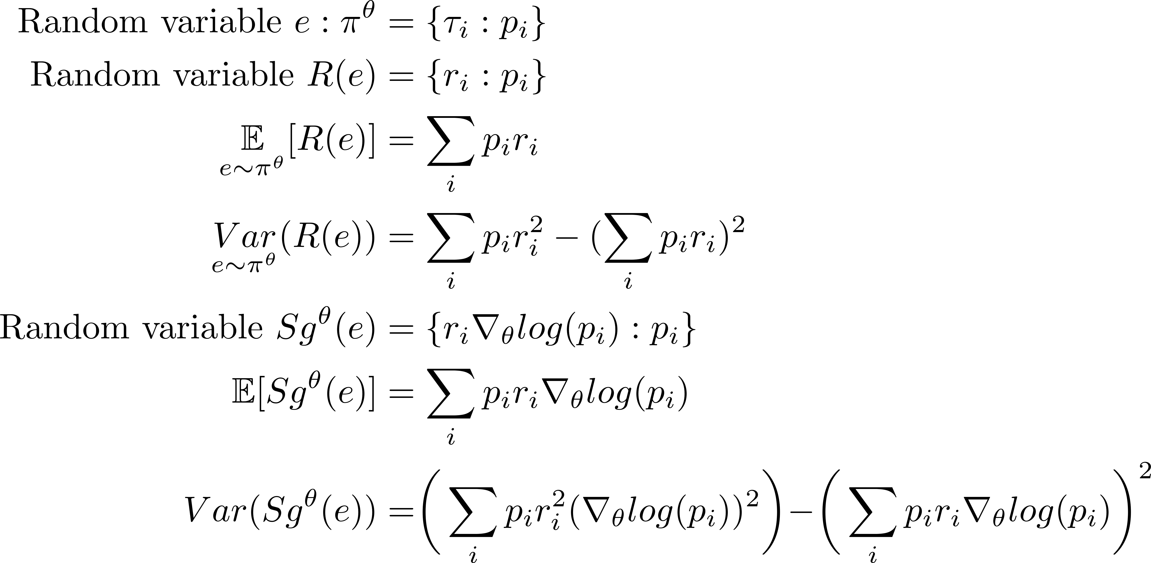
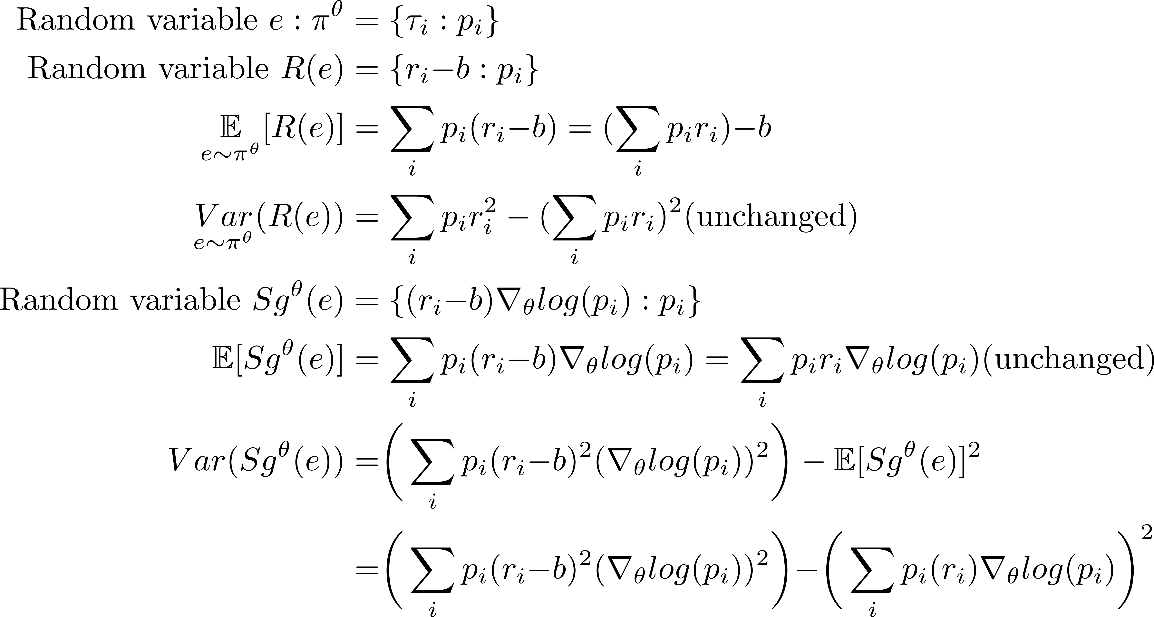
Introducing a baseline
Without baseline
With baseline constant b
Expectation of sample gradient is unchanged when baseline is used
so we can use any baseline in Monte Carlo estimation.

Slide 18
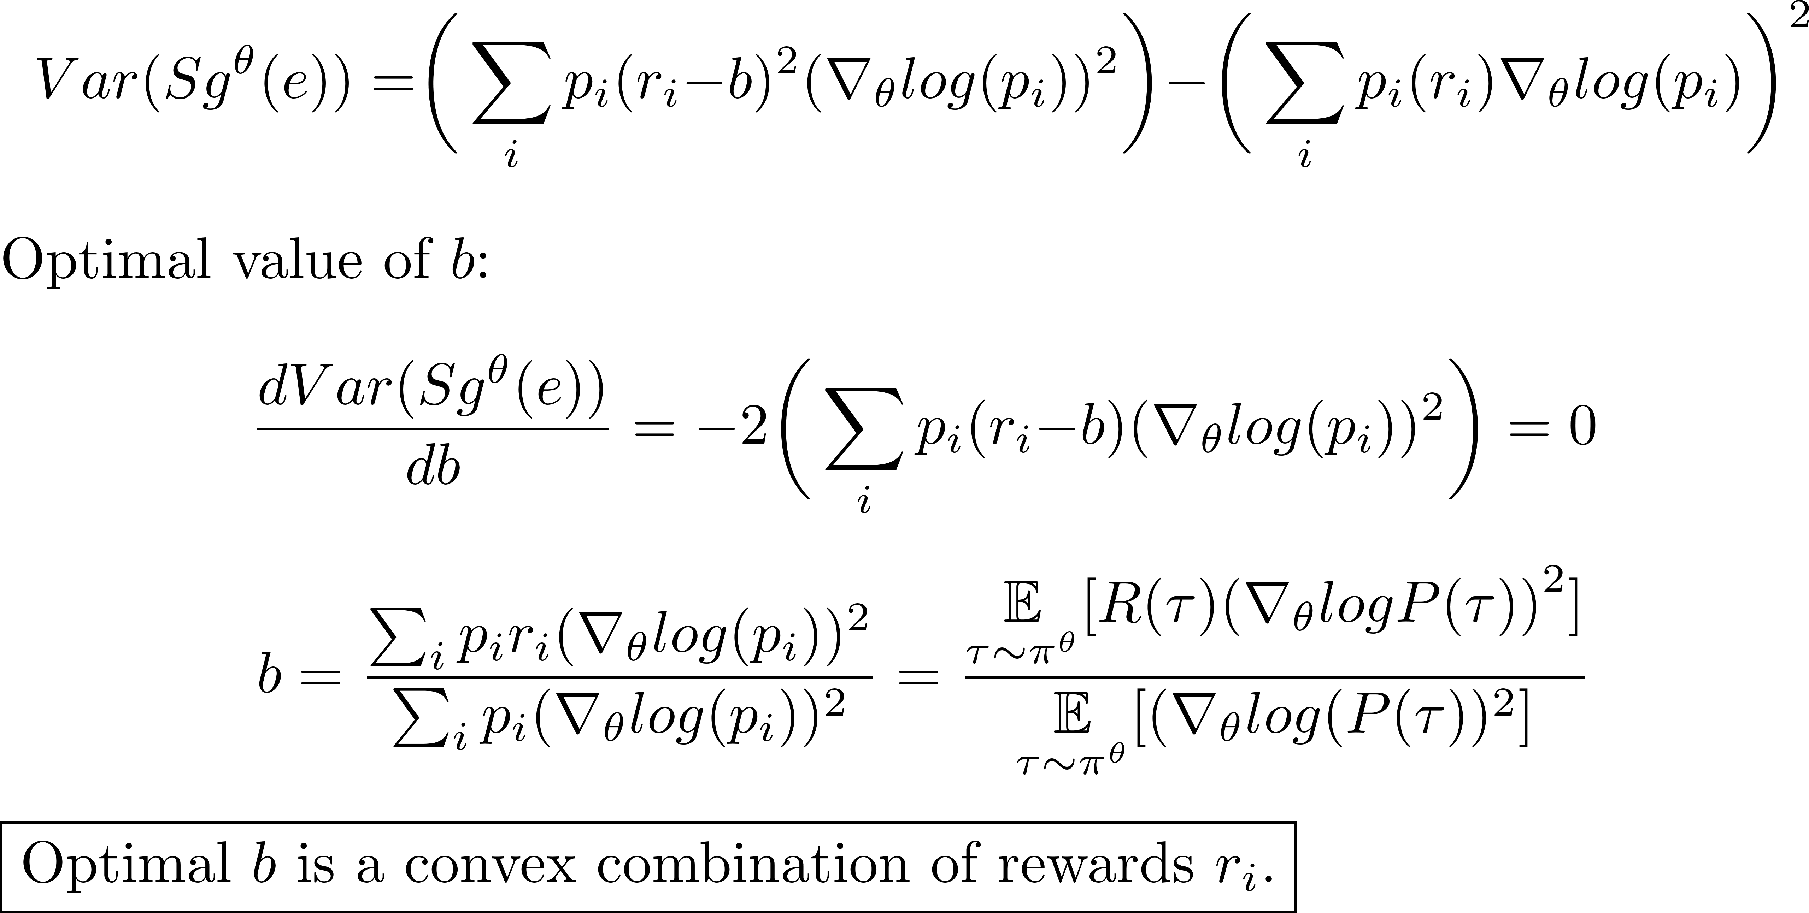
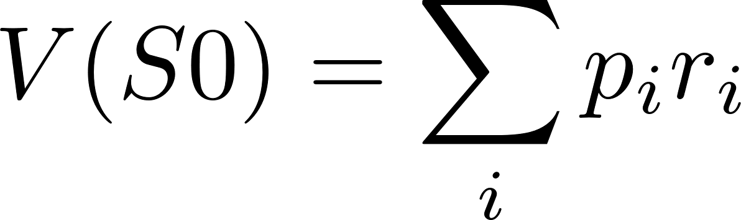
Optimal baseline
S0
τ₁
p₁,r₁
τ₂
p₂,r₂
τ₃
p₃,r₃
In practice, we use V^{θ}(S0), the expectation of return at S0, which is also a convex combination of the rewards.
Since we do not know V^{θ}(S0) , it must also be learned incrementally during training (see later).
Intuition: using V^{θ}(S0) as a baseline adds “history-sensitivity” to gradient updates. If we sampled better trajectories at S0 the last few times we visited S0, reduce gradient update from current episode. We will do this at all states, not just S0.

Slide 19
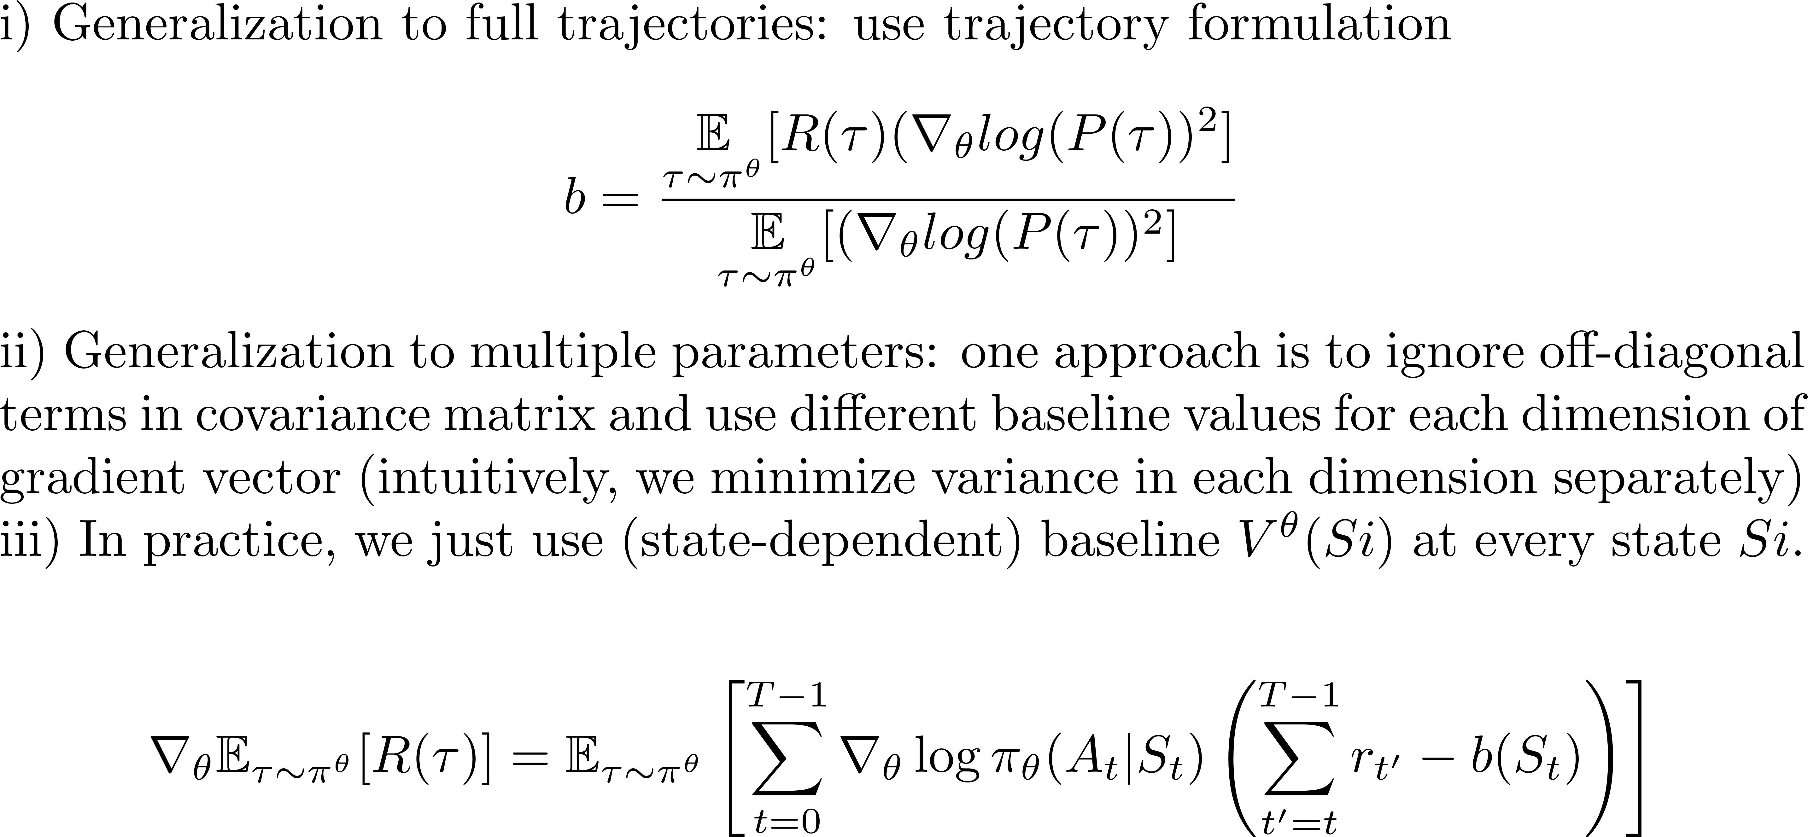
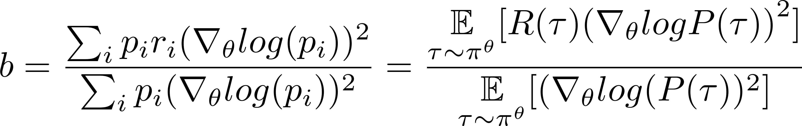
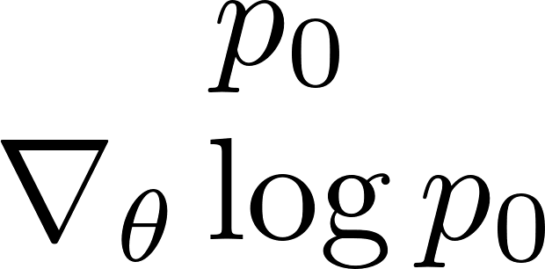
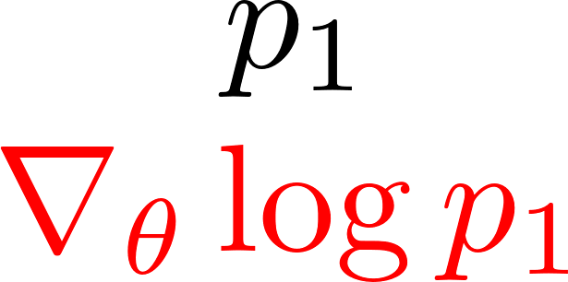
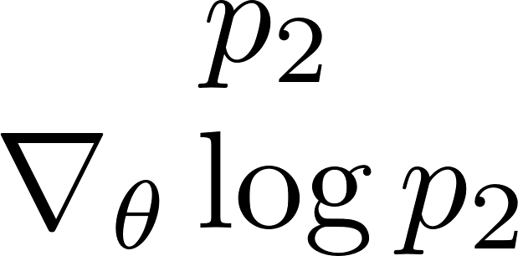
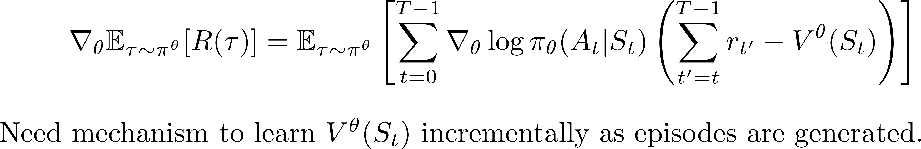
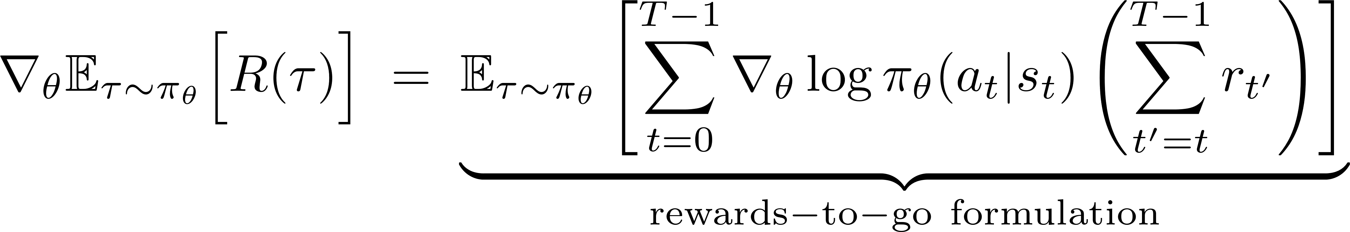
Generalization of optimal baseline
S0
τ₁
p₁,r₁
τ₂
p₂,r₂
τ₃
p₃,r₃
τ:
r₀
r₁
r₂

Slide 20
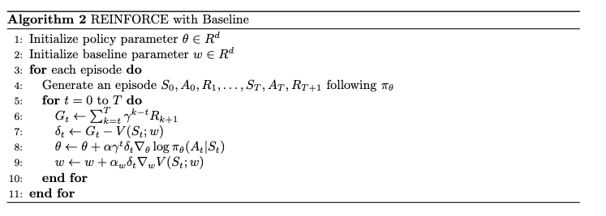
REINFORCE with Value Baseline
Finite states: maintain a State → Value table, updated by each episode
Continuous states: use a NN with parameter w to approximate State → Value table
Calculate diff
Update the policy parameter θ using rewards-to-go
Update the state-value NN parameter w
From Sutton & Barto

Slide 21
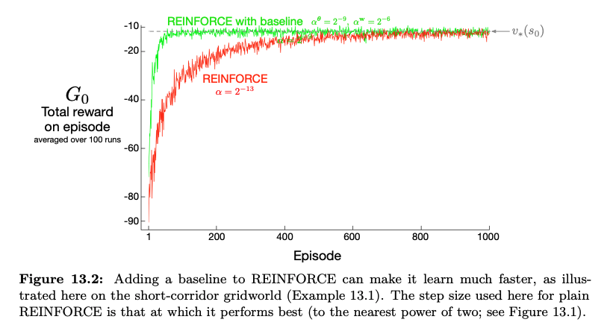
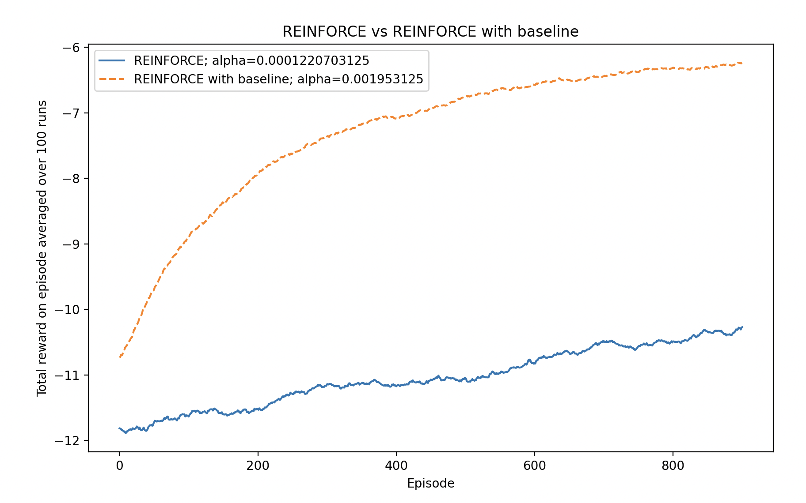
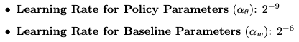
REINFORCE vs
REINFORCE with baseline
Settings:
REINFORCE:
REINFORCE with baseline:
The baseline reduces variance, allowing REINFORCE with baseline to converge faster.

Slide 22
References
Lil’Log: Policy Gradient Algorithms: long blog post on policy gradient algorithms. Well-written.
https://lilianweng.github.io/posts/2018-04-08-policy-gradient/
The Definitive Guide to Policy Gradients in Deep Reinforcement Learning: Theory, Algorithms, and Implementations, Matthias Lehmann. Considers continuous state, continuous action MDPs so lots of double integrals!
https://arxiv.org/pdf/2401.13662
Variance Reduction in Policy Gradient, David Rosenberg NYU-CDS DS-GA 3001 lecture notes. Approaches subject from data science/statistics perspective.
https://davidrosenberg.github.io/ttml2021fall/bandits/6.PG-variance-reduction.pdf
Deep Reinforcement Learning, Sergey Levine, CS 285 Berkeley. Course by one of the leaders in the field.
https://rail.eecs.berkeley.edu/deeprlcourse/
OpenAI Spinning Up. Introduction to Policy Optimization. Has links to libraries and systems resources.
https://spinningup.openai.com/en/latest/spinningup/rl_intro3.html

Slide 23
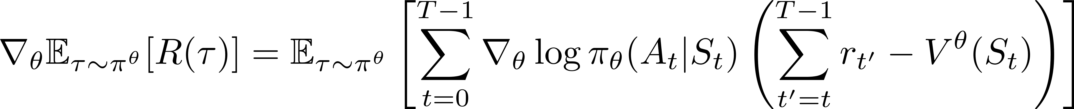
Another formulation: advantage
Since we are tracking state values, use TD(0) error in gradient formula
V^{θ}(S1)
τ:
r₀
r₁
r₂

Slide 24
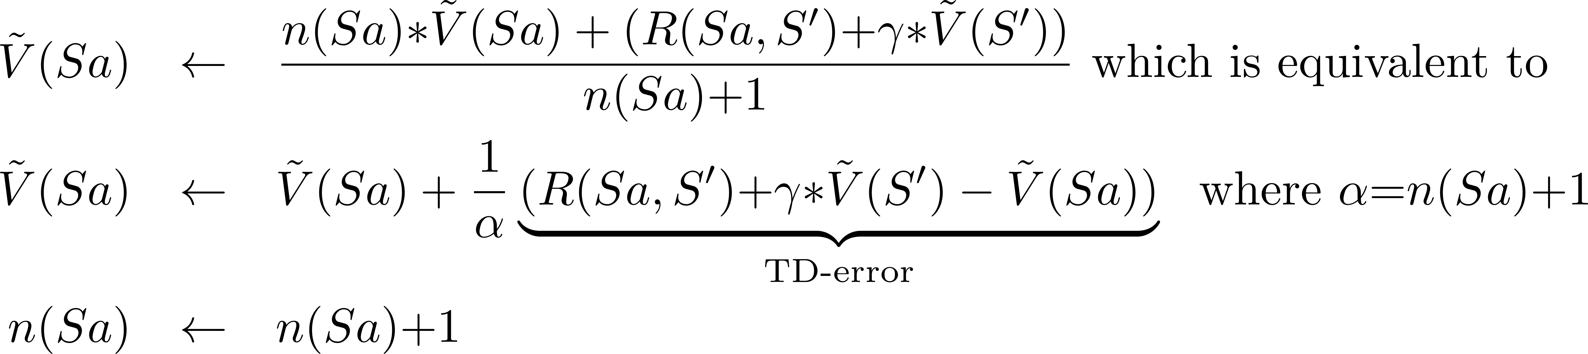
TD(0): online method for value estimation
Ax
Ra
Sa
Sc
Sa
Ay
Sa
Rb
Rc
Sb
π(Sa) = Ax
Sb
Sc
n
Ṽ
Maintain two arrays while processing one-hop samples
n(s) = number of times state s has been visited (initialized to 0)
Ṽ(s)= current estimate of V (initialized arbitrarily)|
New sample <Sa, Ax, R(Sa,S’), S’> comes in

Slide 25
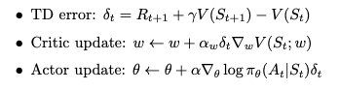
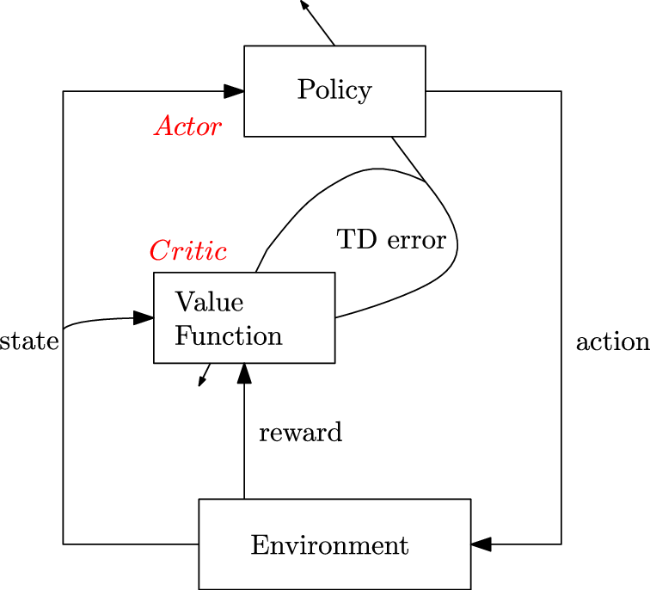
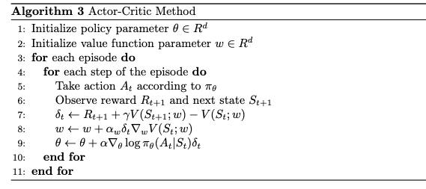
Actor-Critic Methods to Reduce Variance
Actor updates policy parameters by gradient ascent using the value function estimated by the critic
Critic estimates the value function which serves as the baseline
Calculate TD error
Update the value function
Update policy parameters

